Slide 1
Introduction to Programming
Basic C syntax
Variable
Standard Input / Output

Slide 2
Program Structure –
General Form
preprocessing directives
int main(void)
{
declarations
statements
}
Etter/Ingber PSH/JKL

Slide 3
Minimum requirements:
Every C program must have:
  A function – called main, which returns an int.
  A #include <stdio.h> - a "preprocessor directive" which allows it to communicate with the user.
Every C function must have:
  A return type, name and parameter list –
  eg: int main(void)
  int main()
  int main(int argc, char * argv[ ])
  starting and ending braces { }
  A return statement with a value of the right type.
void and an empty list mean the same thing.
We’ll cover this later.
Etter/Ingber PSH/JKL

Slide 4
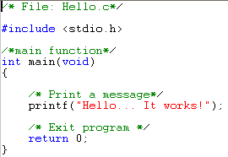
The simplest program…
Optional comment.
Allows program to use screen, keyboard.
Main function – run by the OS.
Etter/Ingber PSH/JKL

Slide 5
The simplest program…
Start of function.
Program statement …
Uses the screen
returns an int – as promised.
End of function.
Etter/Ingber PSH/JKL

Slide 6
Program Structure
Comments begin with the characters /* and end with the characters */
Preprocessor directives give instructions to the compiler
Every C program contains one function named main
The body of the main function is enclosed by braces, { }
Etter/Ingber PSH/JKL

Slide 7
Program Structure - continued
The main function contains two types of commands: declarations and statements
Declarations and statements are required to end with a semicolon (;)
Preprocessor directives do not end with a semicolon
To exit the program, use a return 0; statement
Example: Program chapter1_1.c
Etter/Ingber PSH/JKL

Slide 8
Constants and Variables
All computers have to be able to store data using bytes (groups of bits) as the fundamental storage format.
Computers need to store: input data, output data, temporary values used in calculations
Data is stored in “variables”
It is a named memory location in RAM
  Actual location is determined at “run-time”
  Allow program to keep track of temporary / intermediate data
Etter/Ingber PSH/JKL

Slide 9
Constants and Variables
Computer programs use names (declared by the programmer) to keep track of varibles and constants.
A variable is a memory location that is assigned a type and a
name (or an identifier).
Declaring the variables
int number; int number = 5;
double x; double x=2.83;
char my_grade; char my_grade = ‘P’;
Rules for selecting a valid identifier
  must begin with an alphabetic character or underscore
  may contain only letters, digits and underscore (no special characters, no spaces)
  can not use keywords as identifiers
  case sensitive
identifier
type
Etter/Ingber PSH/JKL

Slide 10
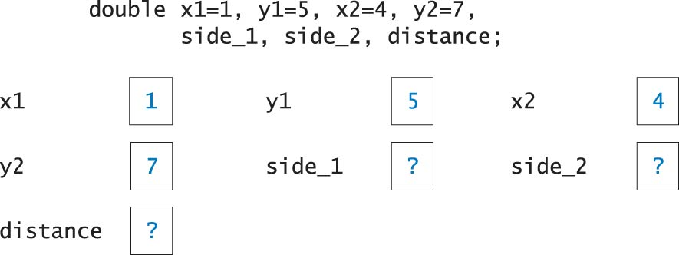
Constants and Variables
Etter/Ingber PSH/JKL

Slide 11
C Data Types
Integers
  short
  int
  long
Floating-Point Values
  float
  double
  long double
Characters
  char
Etter/Ingber PSH/JKL

Slide 12
Symbolic Constants
May be defined with a preprocessor directive
Compiler replaces each occurrence of the directive identifier with the constant value in all statements that follow the directive
Example:
#define PI 3.141593
Constant should preferably be declared with the const keyword:
Example:
const float PI = 3.141593;
Etter/Ingber PSH/JKL

Slide 13
Binary
Digital computers are only capable of recognising two states: off and on (0 and 1) known as bit
To make computer more versatile, bits are combined into bytes. 8 bits = 1 byte
Modern computer support 16-bit (2-byte), 32-bit (4-byte) and 64-bit (8-byte) calculations and memory addressing operations.
4 bytes provides 256⁴ = 4 billion unique states
Etter/Ingber PSH/JKL

Slide 14

Binary
10100100 01000010 01011100
01010011 10101010 01010110
11010111 10101011 11111100
A. Cain

Slide 15
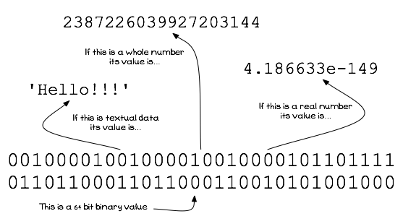
Types determine how the values are interpreted
A. Cain

Slide 16

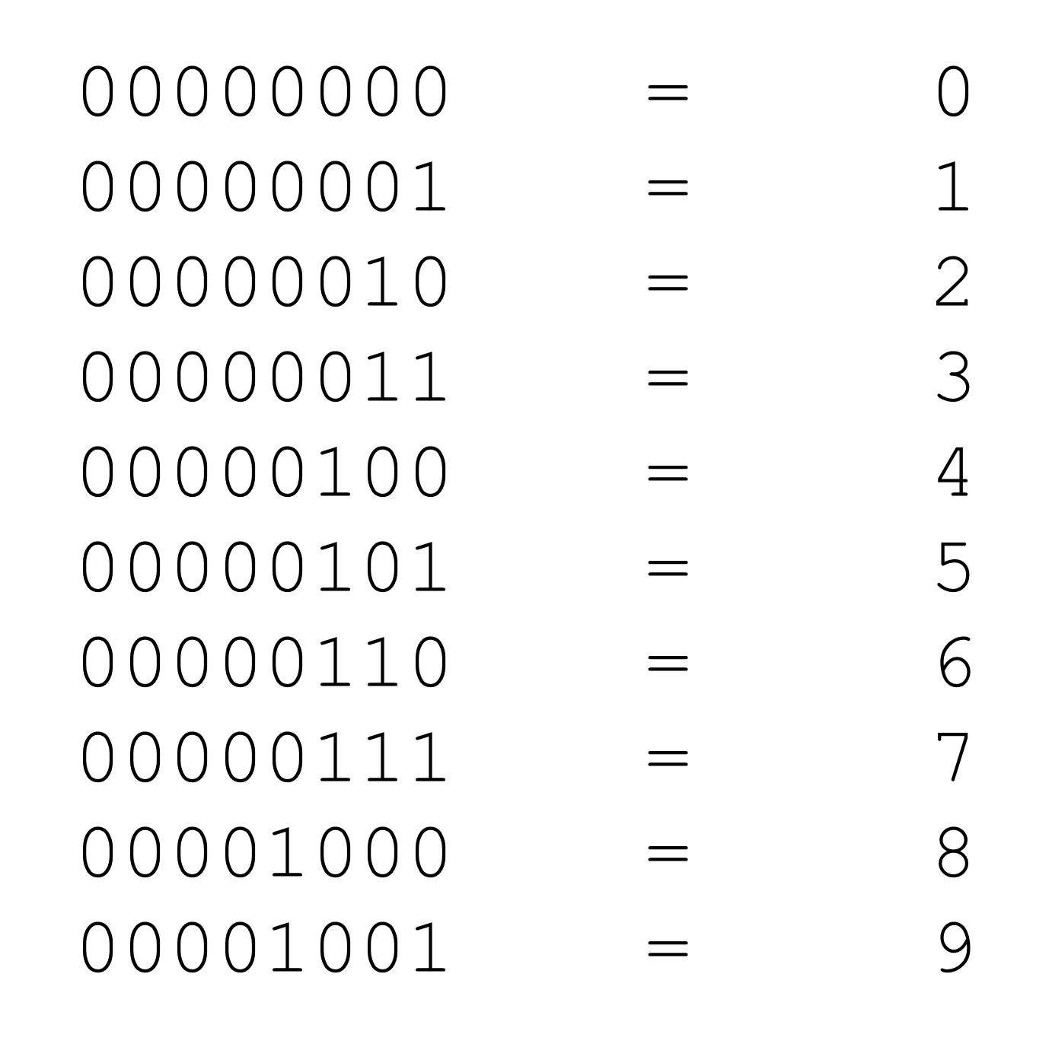
Integer types are stored as their binary value
A. Cain

Slide 17
Common Numeric Types
int – integer (whole number)
on 32-bit (4 bytes) computers, between -2 billion and +2 billion
double – real number (with decimal places)
8 bytes, between -1.7 x 10³⁰⁸ and +1.7 x 10³⁰⁸
15 significant digits, rounding error
char – character
1byte - 256 possible characters (ASCII character set)
string – a set of character
1 byte per character + 1 extra byte
Etter/Ingber PSH/JKL

Slide 18
Character Data
Each character corresponds to a binary code value
ASCII (American Standard Code for Information Interchange) code is used to represent characters
Example of ASCII Codes
  Character ASCII Code integer equivalent
  Newline, \n 0001010 10
  % 0100101 37
  3 0110011 51
  A 1000001 65
  a 1100001 97
  b 1100010 98
  c 1100011 99
Etter/Ingber PSH/JKL

Slide 19
Standard Input / Output

Slide 20
Output
Use printf most of the time.
  stands for “print formatted”
uses a format string (actually a c-string) which contains:
  printable text,
  variable formatting instructions (e.g. %i, %5.2lf, %s),
  special characters.
printf also contains an optional variable list.
e.g.
int data = 20,
double height = 1.753;
printf("My name is Jim\n");
  printf(“I am 20 years old and 1.75cm tall\n”);
  printf(“I am %i years old and %.2f cm tall\n”, data, height);
Etter/Ingber PSH/JKL

Slide 21
printf Special characters
Characters that cannot be added to a c-string can still be used.
Each 2-character code represents 1 special character.
e.g.
\n = new line
\t = tab
\" = double quote
\' = single quote
%% = %.
Etter/Ingber PSH/JKL

Slide 22
printf Variable list…
Can use constants* instead of variables:
  e.g.
  printf("%i %i %i", 23, 34, 0);
  printf("%i %lf %c", 1, 3.48, 'x');
  printf("%s %i", "some words", 0);
  *A constant is a value which cannot change while the program is running
Etter/Ingber PSH/JKL

Slide 23
printf Variable list….
Can use expressions* instead of variables:
  e.g.
  printf("%i+%i=%i", i, j, i+j);
  printf("%lf", 3.48*2.0);
  printf("%lf", sqrt(256.0));
  *mathematical equations that can be evaluated at run-time, or function calls that return the right type of value.
Etter/Ingber PSH/JKL

Slide 24
Standard Input
scanf Function
  inputs values from the keyboard
  required arguments
    formatting string
    memory locations & that correspond to the data types in the formatting string
Example
  double distance;
  char unit_length;
  scanf("%lf %c", &distance, &unit_length);
memory location operator &
REMEMBER: this is a lower case L
Etter/Ingber PSH/JKL

Slide 25
scanf format string
Keep the scanf format string sparse
  No punctuation
  1 space between convertors
  No \n
  No text (prompts)
  No numbers
For doubles and floats, always use %lf
remember to declare variables before using them in scanf
e.g.
char gender;
int age = 0;
double height = 0;
scanf("%i %lf, %c", &age, &height, &gender);
printf(“Gender:%c\n Age:%i Height:%4.2f cm", gender, age, height);
Etter/Ingber PSH/JKL

Slide 26
/* The program prints output lines generated by the "printf" statements */
#include <stdio.h>
int main()
{
int sum = 95;
int x;
double average = 2.1512;
char ch =‘B';
printf("Sum = %i; Average = %.3f \n", sum, average);
printf("Please enter an integer:");
scanf("%i", &x);
sum = sum + x;
x = average;
printf("Character is %c:\nSum is %i %i \n", ch, sum, x);
/* Exit program. */
return 0;
}
Etter/Ingber PSH/JKL

Slide 27
Operators

Slide 28
Assignment Operator
Used to assign a value to a variable
General Form:
  identifier = expression;
Example 1
  double sum = 0; sum
Example 2
  int x;
  x = 5; x
Example 3
  char ch;
  ch = ‘a’; ch
0
5
a
Etter/Ingber PSH/JKL

Slide 29
Assignment Operator - continued
Example 3
  int x, y, z;
  x = y = 0;
  z = 2; x
  y
  z
Example 4
  y = 2; y
0
0
2
2
Etter/Ingber PSH/JKL

Slide 30
Arithmetic Operators
Addition +
Subtraction -
Multiplication *
Division /
Modulus %
  Modulus returns remainder of division between two integers
  Example
    5 % 2 returns a value of 1
Etter/Ingber PSH/JKL

Slide 31
Integer Division
Division between two integers results in an integer.
The result is truncated, not rounded
Example:
  5 / 3 is equal to 1
  3 / 6 is equal to 0
Etter/Ingber PSH/JKL

Slide 32
Priority of Operators
Parentheses Inner most first
Unary operators Right to left
  (+ -)
Binary operators Left to right
  (* / %)
Binary operators Left to right
  (+ -)
Etter/Ingber PSH/JKL

Slide 33
Increment and Decrement Operators
Increment Operator ++
    post increment x++;
    pre increment ++x;
Decrement Operator - -
    post decrement x- -;
    pre decrement - -x;
Etter/Ingber PSH/JKL

Slide 34
Abbreviated Assignment Operator
operator example equivalent statement
  += x += 2; x = x + 2;
  -= x -= 2; x = x - 2;
  *= x *= y; x = x * y;
  /= x /= y; x = x / y;
  %= x %= y; x = x % y;
Etter/Ingber PSH/JKL

Slide 35
Limitations of
Floating Point Numbers

Slide 36
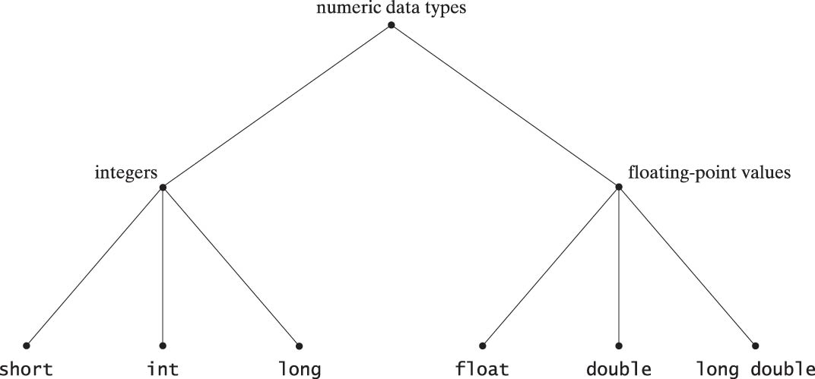
Numeric Data Types
Etter/Ingber PSH/JKL

Slide 37
Scientific Notation
floating-point value expressed in scientific notation is rewritten as:
  mantissa x 10^{exponent}
  Where 1 < |mantissa| < 10; and exponent is an integer
  Examples:
    Floating Point Scientific Exponential
    25.6 2.56 x 10¹ 2.56e1
    -0.004 -4.0 x 10⁻³ -4.0e-3
    1.5 1.5 x 10⁰ 1.5e0
Etter/Ingber PSH/JKL

Slide 38
Scientific Notation
The number of digits the computer allows for the decimal portion of the mantissa determines the precision.
The number of digits allowed for the exponent determines the range.
Example:
  Distance from Mars to Sun in miles is 141,517,510
  (or 1.4151751 x 10⁸)
  To represent this value we need at least 7 digits of precision and an exponent range that includes the integer 8
Etter/Ingber PSH/JKL

Slide 39
Limits of Number Types
Differences between float, double, and long double types relate to the precision and the range of the values represented.
Precision and range are system dependent and can vary with the operating system or compiler.
Etter/Ingber PSH/JKL

Slide 40
Limitations of Floating-Point Numbers
Because of the imprecision of the floating point number representation, comparison between
floating point numbers is dangerous!
Example:
  DoubleTrouble.C_x000b_
double x = 9.3 * 0.1;
double y = 0.93;
if (x = = y)
printf("they're equal of course\n");
else
printf("not equal?!? How come?\n");
Which one will print ?
Etter/Ingber PSH/JKL

Slide 41
Type Conversion (type casting)
It is sometimes necessary to convert one type into another
Example:
  double result;
  result = 2 / 3;
  result = (double)2 / 3;
Integer division => Result = 0 ?
Probably not what is wanted
After converting “2” to double, a
floating point division gives:
result = 0.66666666..
Etter/Ingber PSH/JKL

Slide 42
Type Conversion (type casting)
Casting as you go:
  double x = (double)3 / (double)2 * (double)27;
Casting the whole set of double operations back to an int using brackets:
  double z = (double)5 / (double)2 * (double)27;
  int i = (int)((double)5 / (double)2 * (double)27); (z = 67.5, i = 67)
Etter/Ingber PSH/JKL

Slide 43
Character Functions
Functions available when you #include <ctype.h>
toupper(ch) If ch is a lowercase letter, this function returns the corresponding uppercase letter; otherwise, it returns ch
isdigit(ch) Returns a nonzero value if ch is a decimal digit; otherwise, it returns a zero.
islower(ch) Returns a nonzero value if ch is a lowercase letter; otherwise, it returns a zero.
isupper(ch) Returns a nonzero value if ch is an uppercase letter; otherwise, it returns a zero.
isalpha(ch) Returns a nonzero value if ch is an uppercase letter or a lowercase letter; otherwise, it returns a zero.
isalnum(ch) Returns a nonzero value if ch is an alphabetic character or a numeric digit; otherwise, it returns a zero.
Etter/Ingber PSH/JKL

Slide 44
Math Functions
Functions available when you #include <math.h>
  fabs(x) Absolute value of double x.
  abs (i) Absolute value of int i
  sqrt(x) Square root of x, where x >= 0.
  pow(x,y) Exponentiation, xy.
  Errors occur if x < 0 or y < 0.
  ceil(x) Rounds x to the nearest integer toward ∞ (infinity).
  eg, ceil(2.01) is equal to 3.
  floor(x) Rounds x to the nearest integer toward -∞ negative infinity). e.g., floor(2.01) is equal to 2.
  exp(x) Computes the value of ex.
  log(x) Returns ln x, the natural logarithm of x to the base e. Errors occur if x <= 0.
  log10(x) Returns log10x, logarithm of x to the base 10.
  Errors occur if x <= 0.
Etter/Ingber PSH/JKL

Slide 45
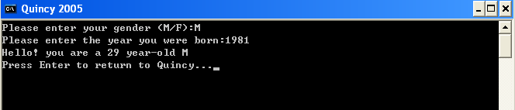
Practice! Complete the program below…
main()
{
int year;
char gd;
printf(“Please enter your gender (M/F):”);
}
Etter/Ingber PSH/JKL

Slide 46
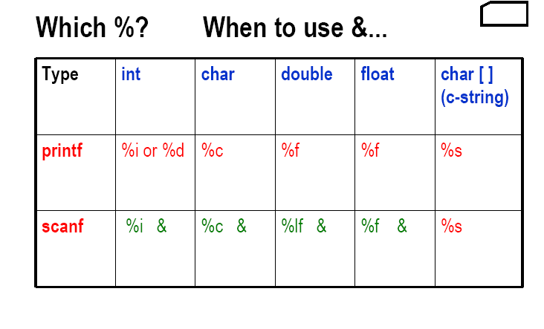
Summary
Etter/Ingber PSH/JKL

